Slide 1

Data Viz Bootcamp Team 2 Project 1 presentation
January 12, 2021
Alex Goldstein, Jeff Johnson, Al Misa, Susan Skinner, Ciara Spencer, Danielle White

Slide 2
Project Title – Film Budgets and Box Office Revenue Project Description / Outline: Our project aims to find correlative trends among films produced from 2006 to 2018 that correspond with budget and box office revenue. We’ll examine relationships between genre, date of release, MPAA rating and domestic and international revenue.

Slide 3
Datasets #1. The Numbers: from Opus Data (DataSet .csv file) About the dataset: Film Data for Movies produced between 2006 -2018, figures for domestic and international box office with productions over $10 Million. 1,900 films with data values for movie name, production year, movie id, production budget, domestic box office, international box office, rating, creative type, source, production method, genre, sequel, running time. - Consistent numbers are provided within the data set with minimal NaN values for: movie name, production year, movie id, production budget, domestic box office, international box office, rating, creative type, source, production method, genre, and sequel. - Column for running time is insufficient for data values for majority of the films listed. Well Documented: “OpusData is backed by a rigorous classification methodology that makes it possible for independent producers, investors and industry researchers to build accurate financial models and to measure the performance of individual movies, production companies, studios, market segments, and the industry as a whole.”

Slide 4
Datasets #2 OMDB: (API) About the database: An API to obtain relevant movie information for title, release year, MPAA rating, date released, runtime, genre, director, writer, plot synopsis, languages, country released, nominations, ratings (IMDB, Rotten Tomatoes, Metacritic, Metascore), box office revenue, and production company.

Slide 5
Data Cleanup efforts ▪ Importing CSV ▪ Running calculations for new columns ▪ Running tests for API ▪ Looping through list of movie titles ▪ Appending API data ▪ Searching for missing titles ▪ Running counts & merging dataframes ▪ Reducing columns for analysis ▪ Exporting dataframe as CSV

Slide 6
Review Jupyter Notebook

Slide 7
Jeff side by side comparison / conclusions

Slide 8
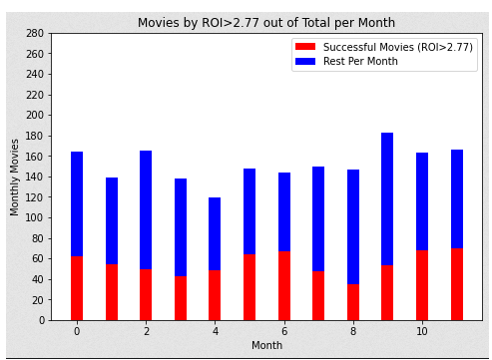
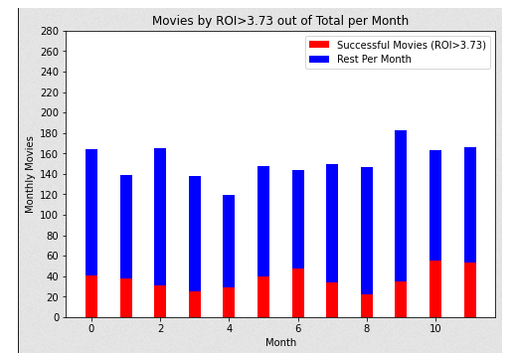
Movies BY roi BY mONTH

Slide 9
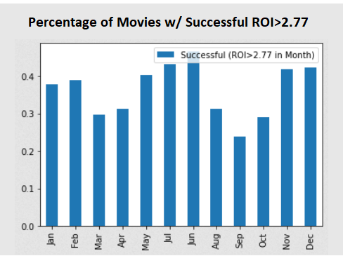
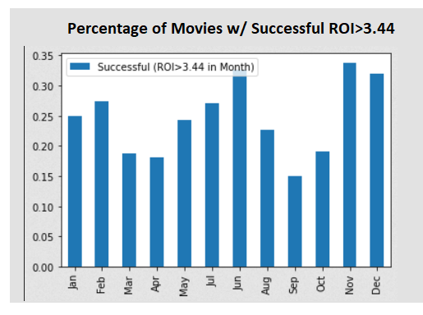
Movies with successful ROI

Slide 10
Ciara side by side comparison / Conclusions

Slide 11
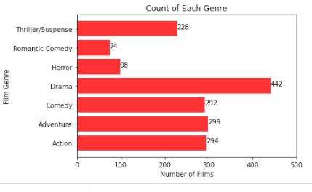
Count of films by genre

Slide 12
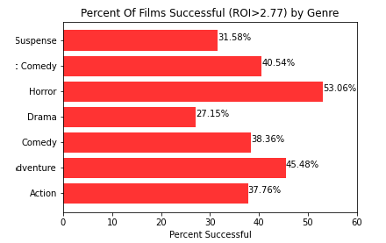
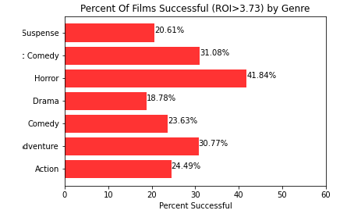
Percent of successful films by genre using 2.77% and 3.73% ROI

Slide 13
Alex side by side comparison / conclusions

Slide 14
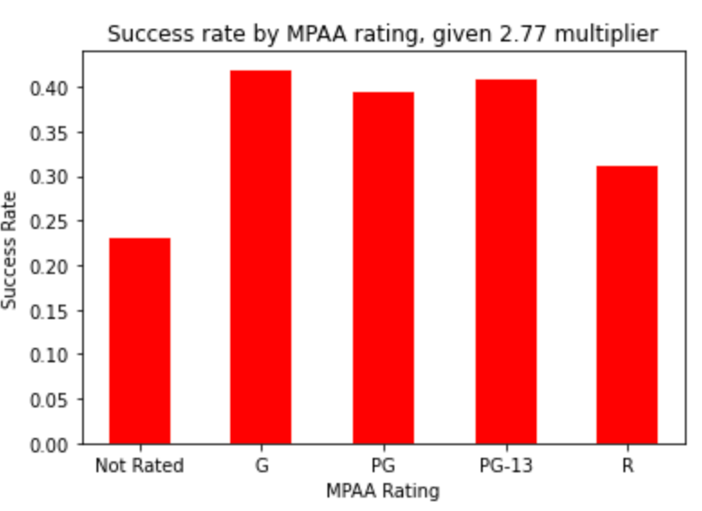
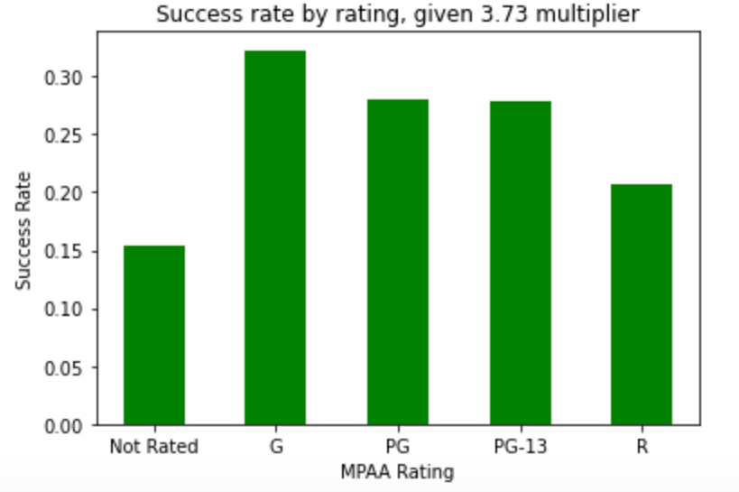

Slide 15
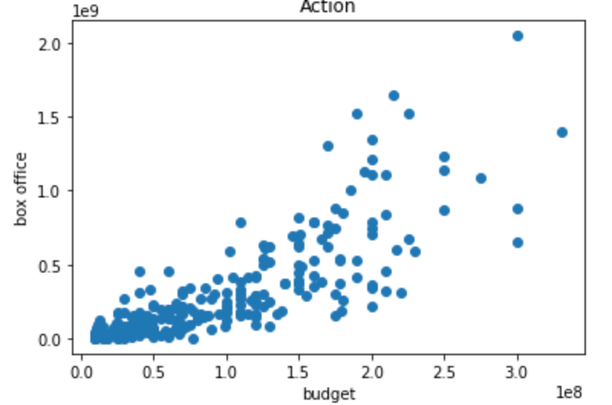
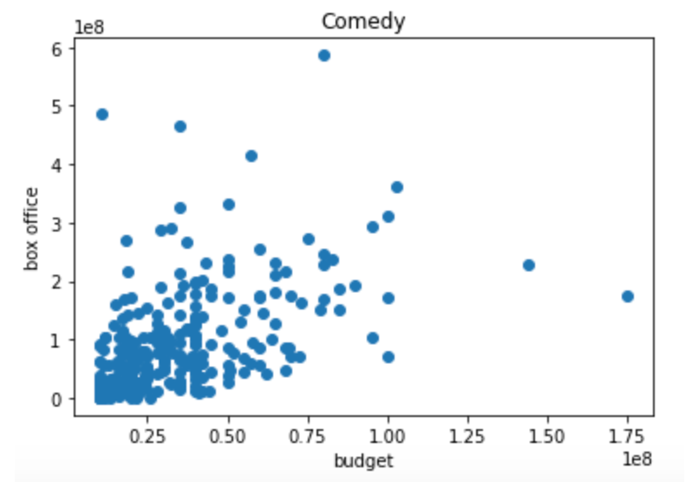

Slide 16
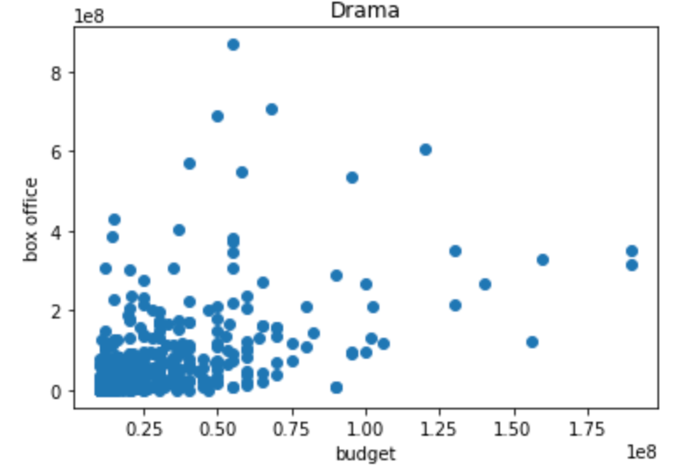
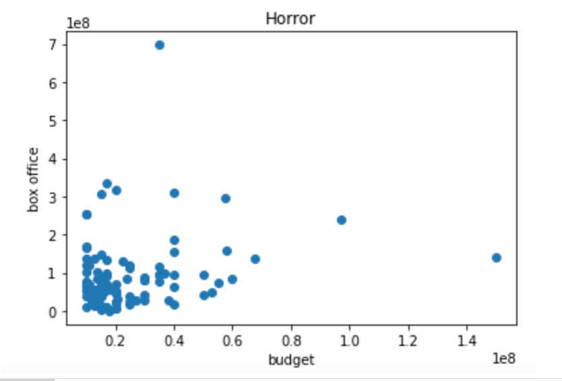

Slide 17
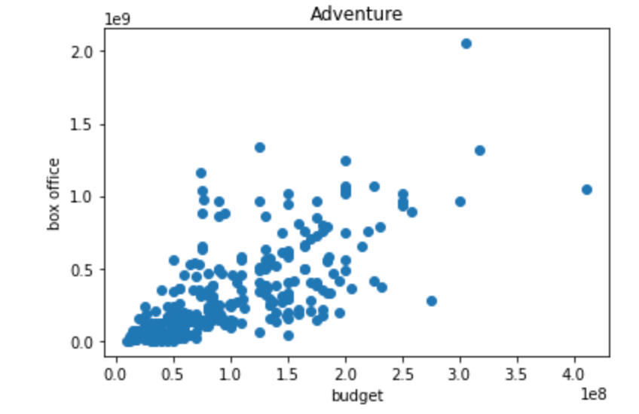
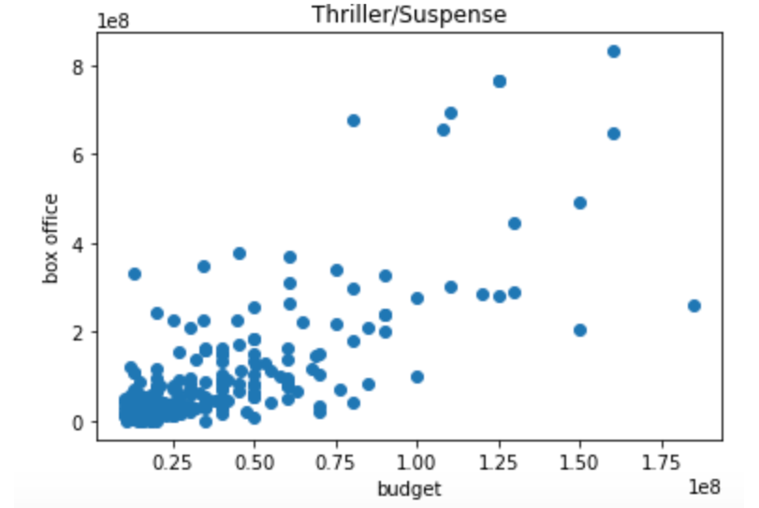

Slide 18
Al’s side by side comparison / Conclusions

Slide 19
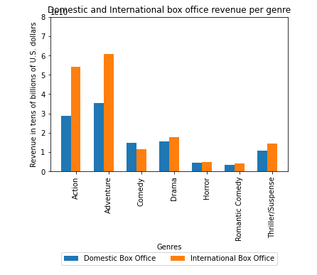
Domestic and international box office revenue per genre

Slide 20
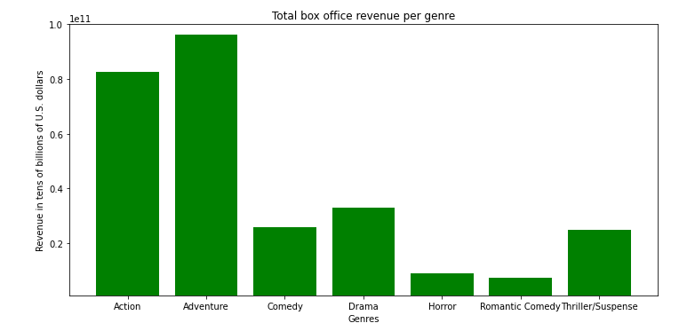
Total revenue per genre

Slide 21
Sue side by side comparison / conclusions

Slide 22
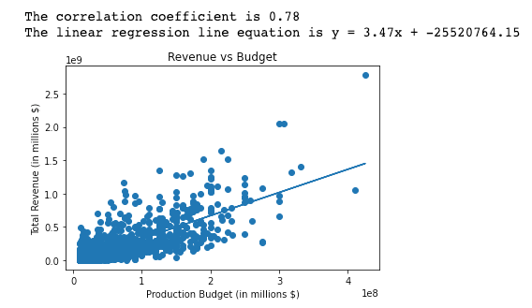
Total Revenue (millions) vs budget (millions)

Slide 23
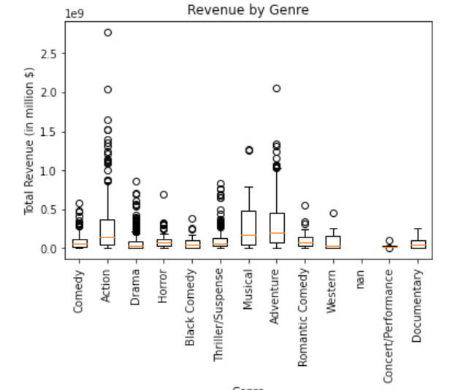
Total revenue (millions) by genre

Slide 24
Danielle side by side comparison / conclusions

Slide 25
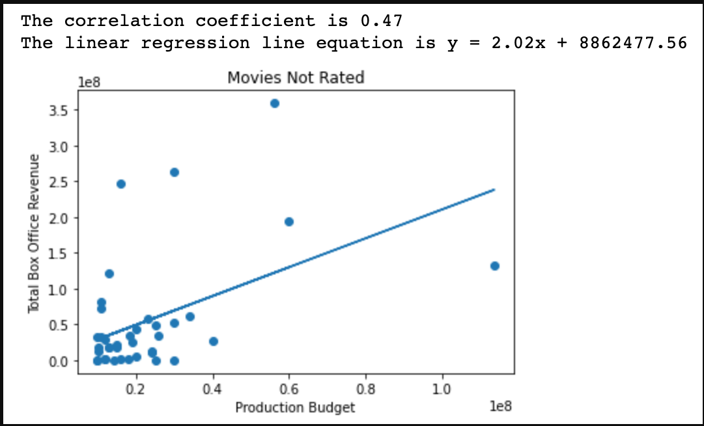
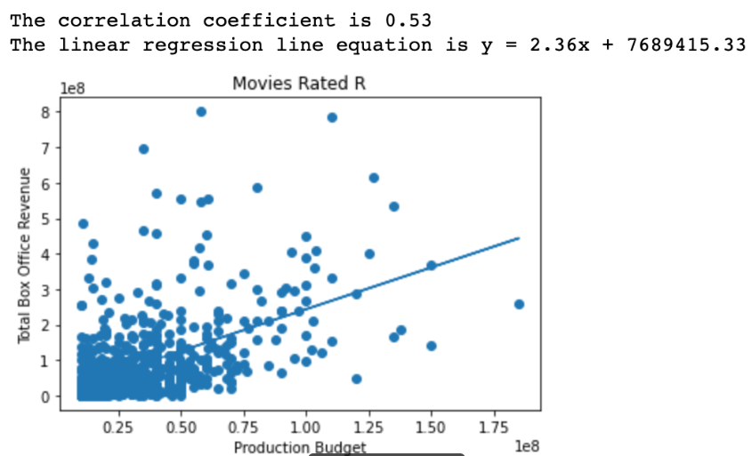

Slide 26
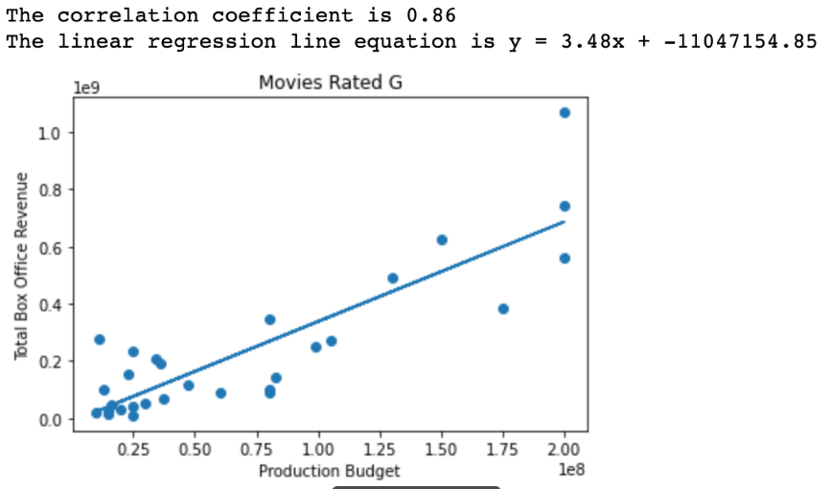
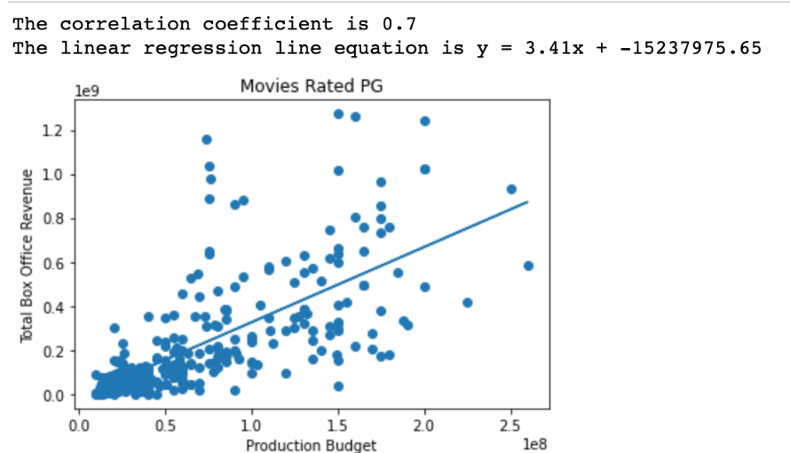
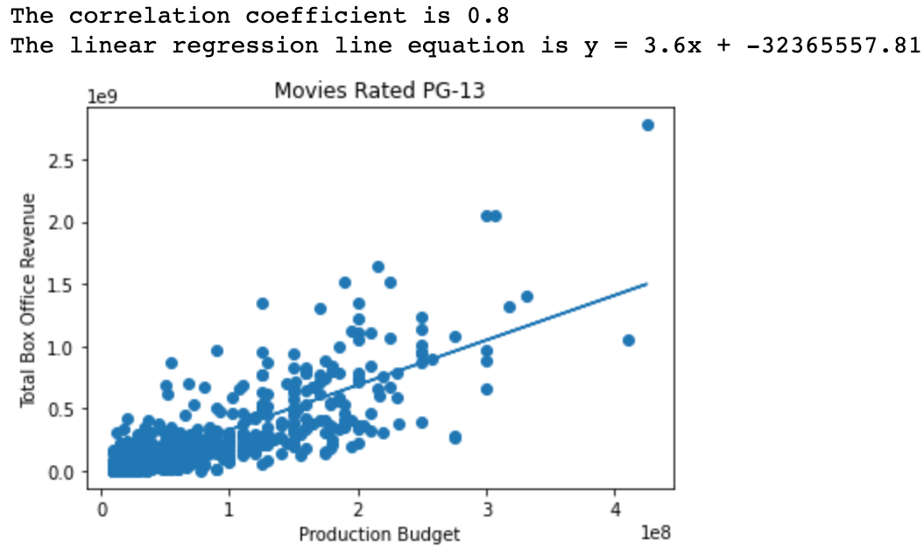

Slide 27
Post-mortem findings

Slide 28
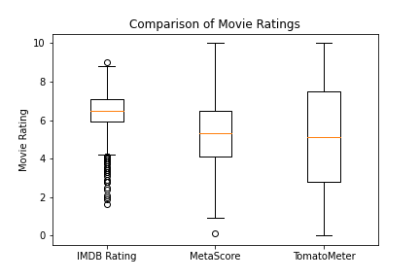
Comparison of movie rating systems

Slide 29
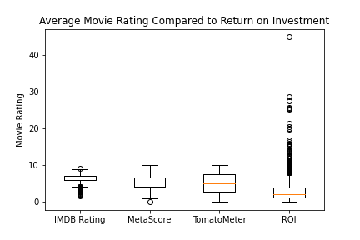
Compare different movie rating systems to roi

Slide 30
QUESTIONS?

